Slide 1
Medium Access Control in Data Link Layer
SMU, 휴먼지능정보공학과

Slide 2
Contents
Data Link Layer Overview
Medium Access Control
Brief Introduction to Wireless Medium
Random Access
ALOHA
CSMA
CSMA/CD
CSMA/CA
Controlled Access
Channelized Access

Slide 3
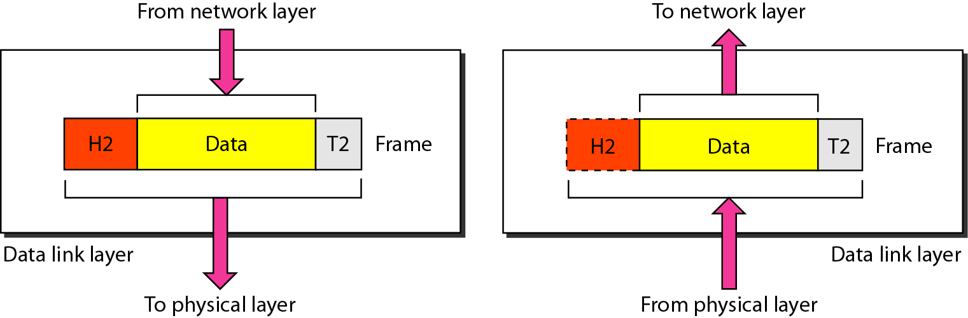
Data Link Layer
The data link layer provides a reliable (error-free) link
Transfer data from the network layer of one machine to the network layer of another machine using hop by hop transmission over single links.
Convert the raw bit stream of the physical layer into groups of bits (“frames”) and vice versa

Slide 4
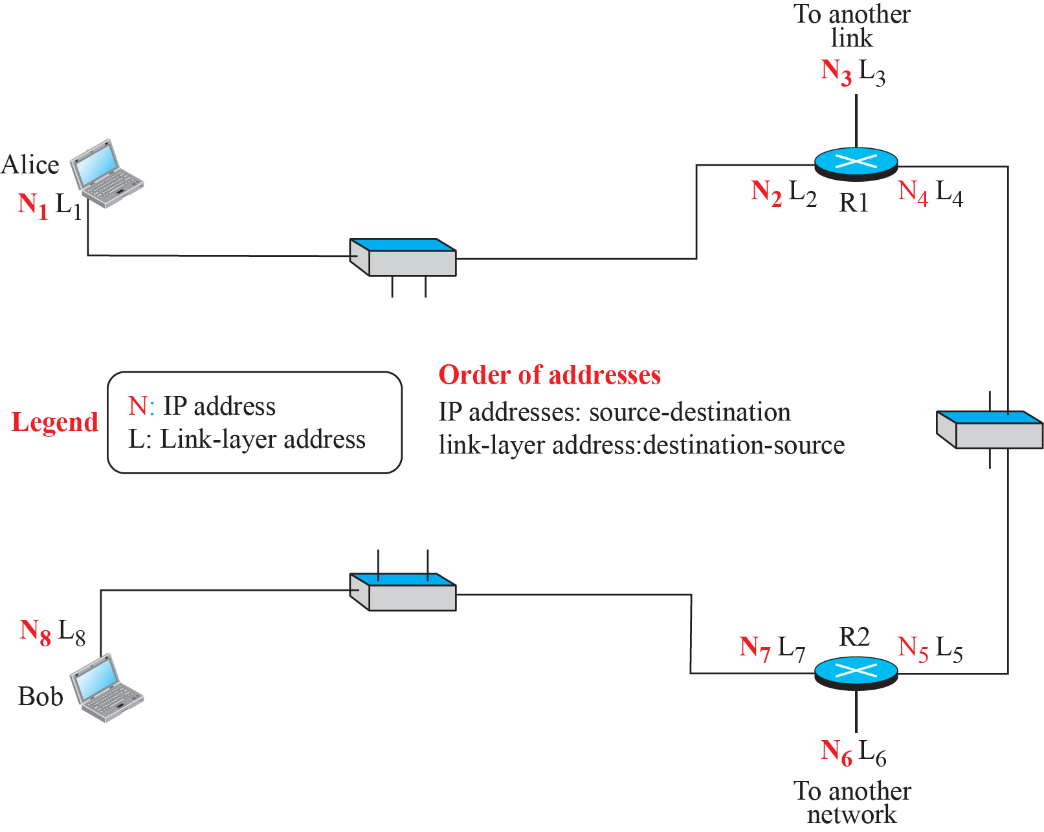
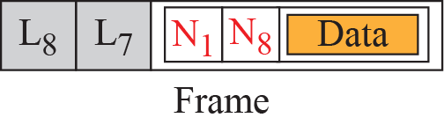
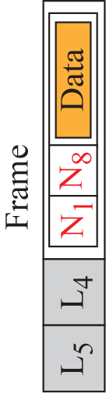
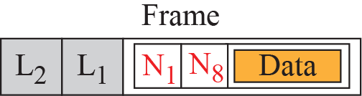
IP address & Data Link layer address
L2
L1
L8
L7

Slide 5
Data Link Layer: Duties
Framing
Physical addressing
Flow control
Error control
Medium Access control
determines how to share a link by many hosts
Logical Link Control sublayer

Slide 6
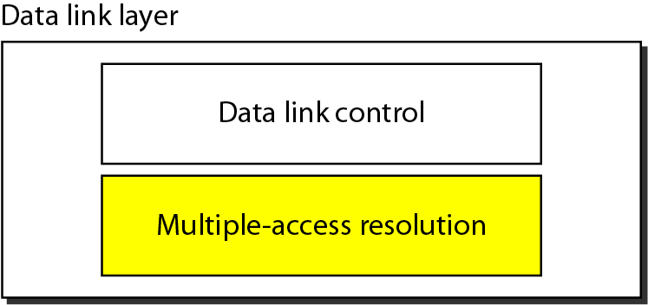
Data Link Layer: Two sublayers
Data link layer can be divided into two functionality-oriented sublayers
IEEE made this division for Data Link Layer in LAN(Local Area Network)s
Logical Link Control (LLC) sublayer
Medium Access Control (MAC) sublayer

Slide 7
Contents
Data Link Layer Overview
Medium Access Control
Brief Introduction to Wireless Medium
Random Access
ALOHA
CSMA
CSMA/CD
CSMA/CA
Controlled Access
Channelized Access

Slide 8
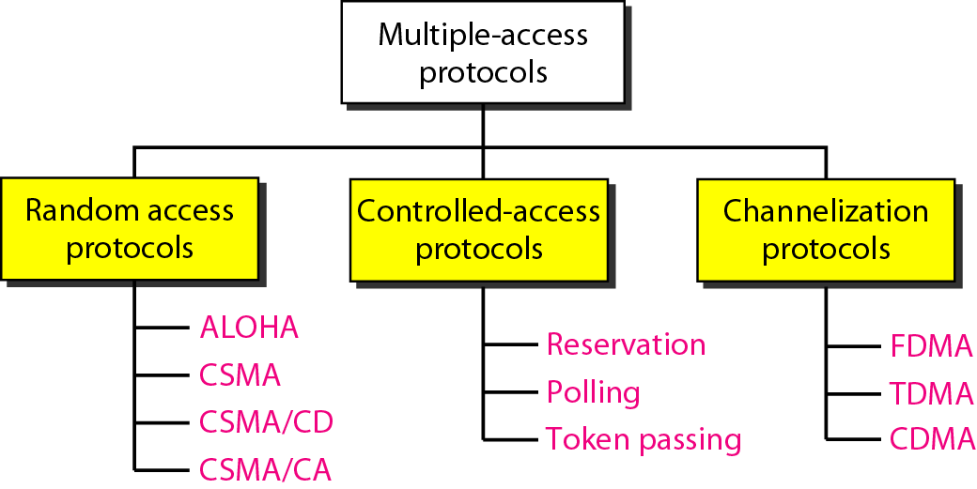
Medium Access Control = Media Access Control = Multiple Access protocols

Slide 9
Contents
Data Link Layer Overview
Medium Access Control
Brief Introduction to Wireless Medium
Random Access
ALOHA
CSMA
CSMA/CD
CSMA/CA
Controlled Access
Channelized Access

Slide 10
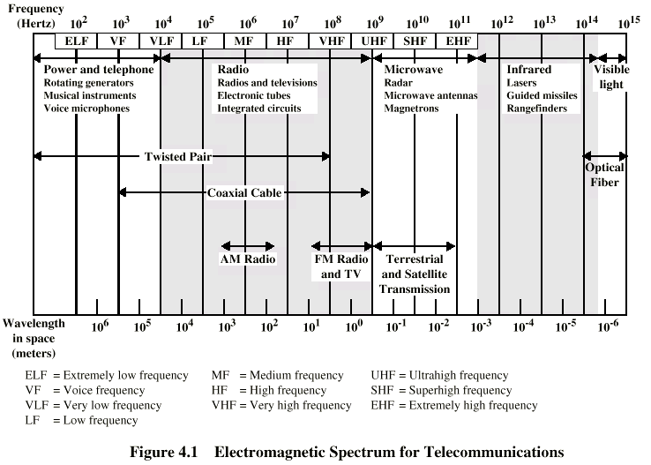
Electromagnetic Spectrum for wireless

Slide 11
Wireless Link Characteristics
Differences from wired link:
decreased signal strength: radio signal attenuates as it propagates through matter (path loss)
interference from other sources: standardized wireless network frequencies (e.g., 2.4 GHz) shared by other communication devices (e.g., phone); other devices (microwave oven, motors) interfere as well
multipath propagation: radio signal reflects off objects ground, arriving ad destination at slightly different times
make communication across (even a point to point) wireless link much more “difficult”

Slide 12
Wireless Signal Attenuation
Signal attenuates logarithmically with the distance
P_{recv} ∝ P_{send} * (1/r)^{n}
r is the distance between sender and receiver
n is the path loss exponent which is characteristic of the environment. Usually, between 2 in free space, to up to 6 indoors
To receive correctly, the received signal power should be high enough, compared to the noise level (Signal to Noise ratio, SNR)

Slide 13
Effect of signal attenuation
Transmission range
communication possible
low error rate
Detection range
detection of the signal possible
no communication possible
Interference range
signal may not be detected
signal adds to the background noise
sender
transmission
distance
detection
interference
No effect

Slide 14
Multiple node case
Multiple wireless senders and receivers create additional problems (beyond multiple access):
A
B
C
C
A’s signal
strength
C’s signal
strength
B
A
Hidden terminal problem
B, A hear each other
B, C hear each other
A, C can not hear each other
means A, C unaware of their interference at B
space
Signal fading (Another hidden terminal problem):
B, A hear each other
B, C hear each other
A, C can not hear each other interfering at B

Slide 15
Contents
Data Link Layer Overview
Medium Access Control
Brief Introduction to Wireless Medium
Random Access
ALOHA
CSMA
CSMA/CD
CSMA/CA
Controlled Access
Channelized Access

Slide 16
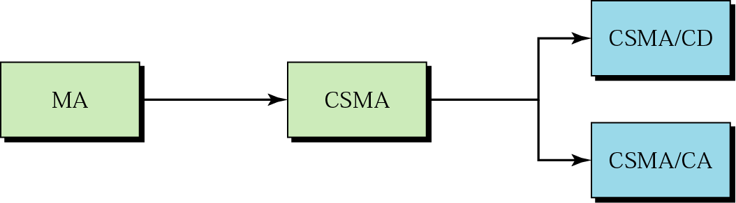
Random Access
Each station has the right to access the medium without being controlled by any other station
Collision, an access conflict, if more than one station tries to send
Collision Detection
Multiple Access
Carrier Sense
Multiple Access
Collision Avoidance

Slide 17
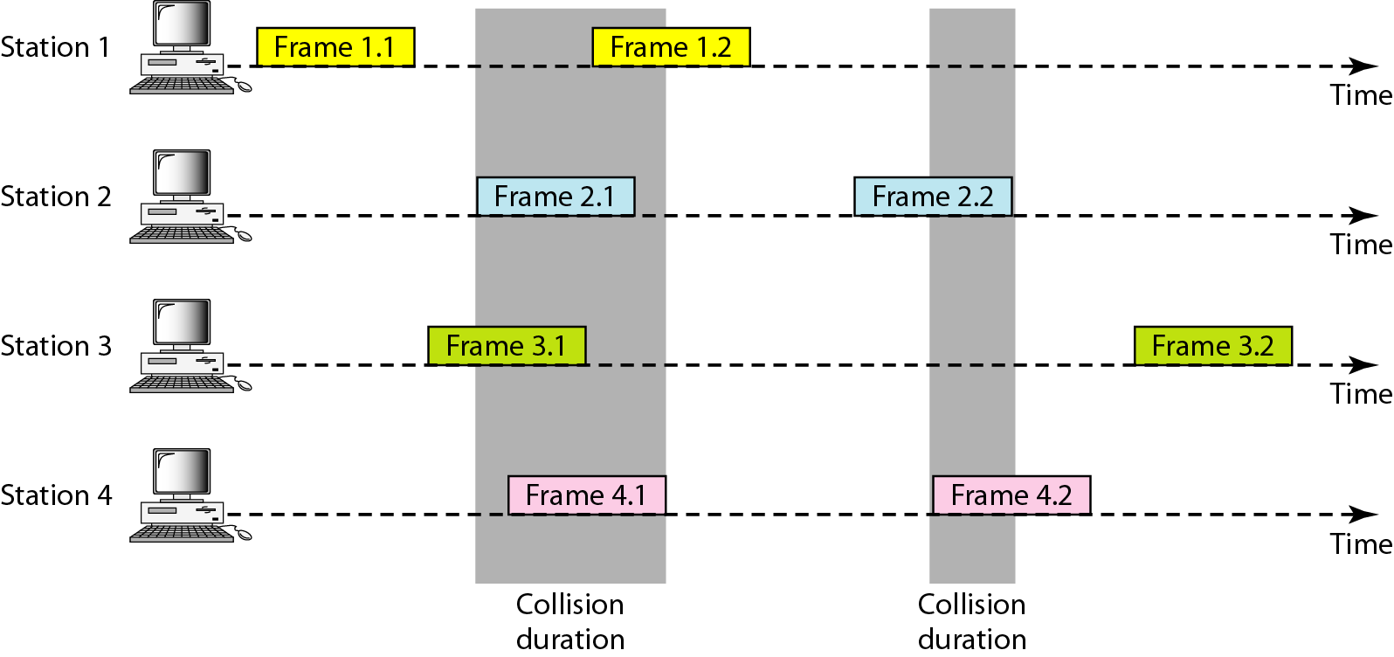
ALOHA
The earliest random access method developed at the Univ. of Hawaii in the early 1970s
Designed for a radio (wireless) LAN
ALOHA and Slotted ALOHA
Frames in an ALOHA network:
How do we detect a collision?
When do we resend a collided frame?

Slide 18
ALOHA Basic Assumptions
Station model - n independent stations each generating frames for transmission. One frame is generated and transmitted at a time per station.
Single channel - A single channel is shared with other stations.
Collision - Overlapping transmissions destroy the frames, can be detected later by some upper layer functions, and require retransmission. Collisions are the only errors.

Slide 19
ALOHA protocol: Basics
When a station wants to transmit, it transmits
Collisions are detected at a higher layer of the receiving station.
If no collision, an Acknowledgement (ACK) frame is sent back to the transmitting station.
If collision, ACK will not be sent. The transmitting station will retransmit later.
Simple logic
Highly inefficient at large loads. Maximum utilization of 18% at a mean load of 0.5 transmission

Slide 20
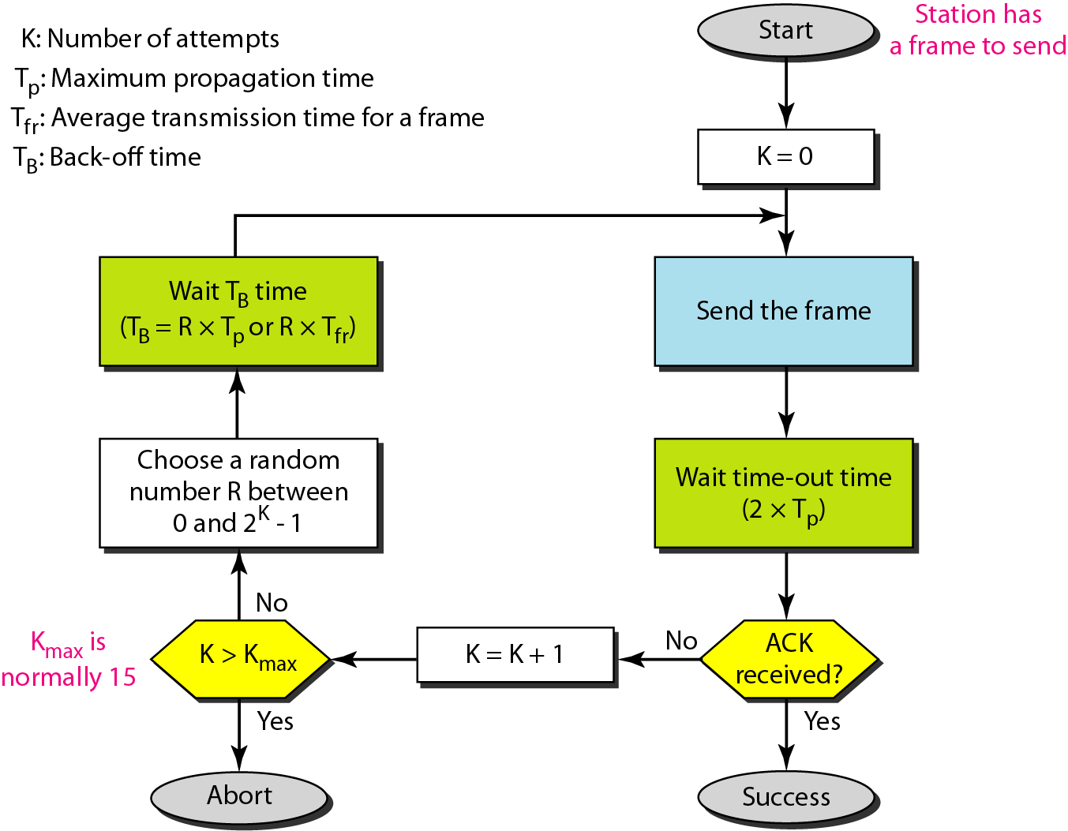
ALOHA Protocol: Retransmission Procedure
Binary exponential back-off algorithm

Slide 21
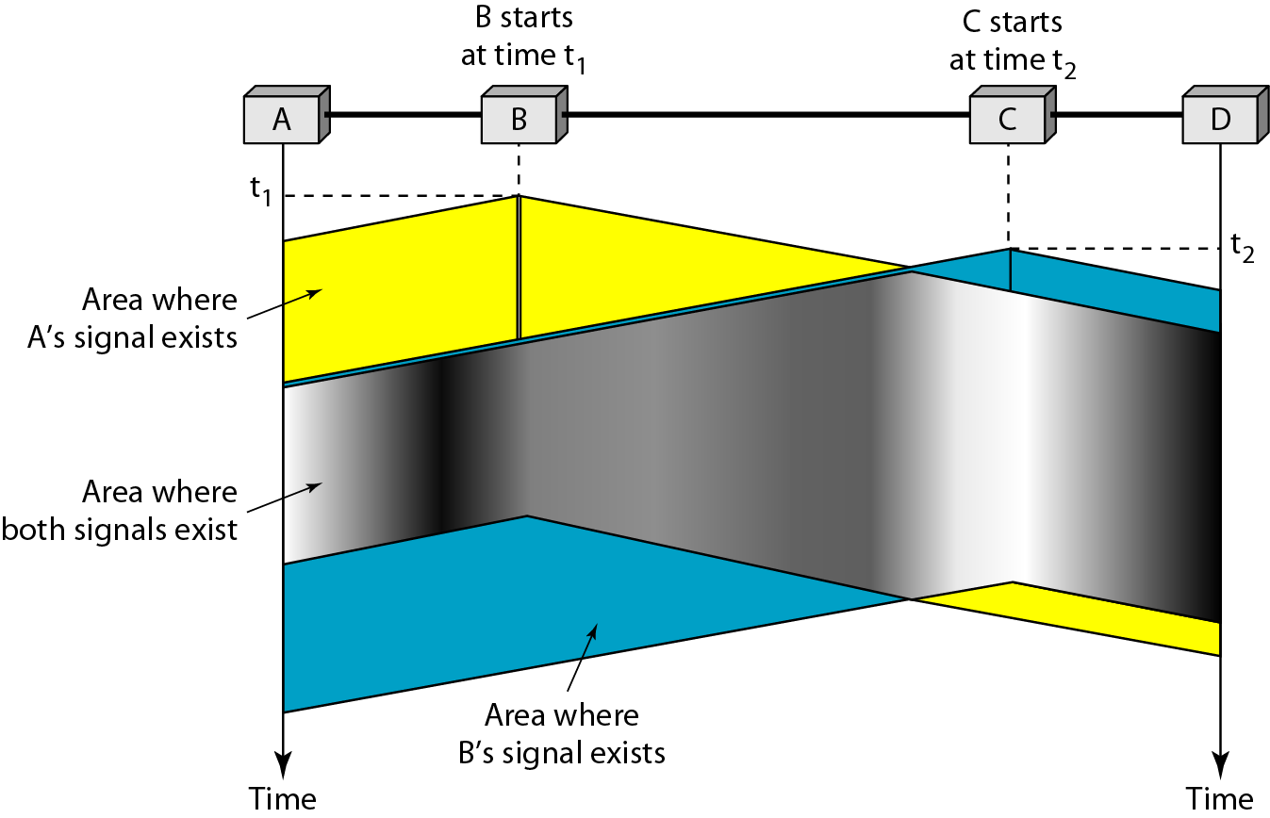
Carrier Sense Multiple Access (CSMA)
What if we can sense whether medium is busy?
CSMA
“Sense before transmit”
“Listen before talk”
CSMA can reduce the possibility of collision, but it can not eliminate it because of propagation delay

Slide 22
CSMA/CD
Senders can detect collision. How can we improve the efficiency?
CSMA with collision detection(CD):
Listen while you are sending a packet (this is how you detect collision)
Stop sending when collision happens
Exponential back-off: Wait random time before you attempt to resend.
IEEE 802.3 standard, Ethernet

Slide 23
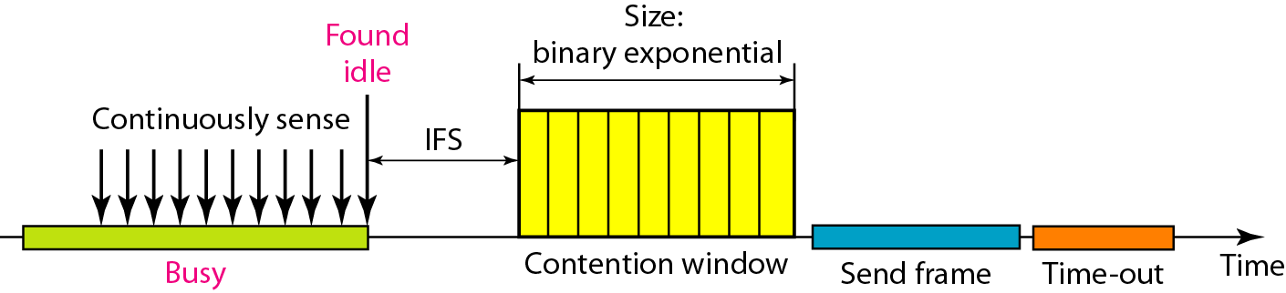
Case in Wireless network
In wireless network, a sender cannot detect collision.
Signal level is variable and is a function of distance.
Sender’s transmission level can be much larger than a received signal level
How can we improve the efficiency of CSMA?
Three strategies
When idle found, wait for some time and then randomly choose when to transmit: Inter frame space & Contention window
Wait for ACK

Slide 24
CSMA/CA (Collision Avoidance)
These strategies are called CSMA/CA collectively.
What if another station transmit during Contention window?
We do not reset the back-off counter. We stops the timer and restarts it when the channel becomes idle
IFS may be used for priority control.

Slide 25
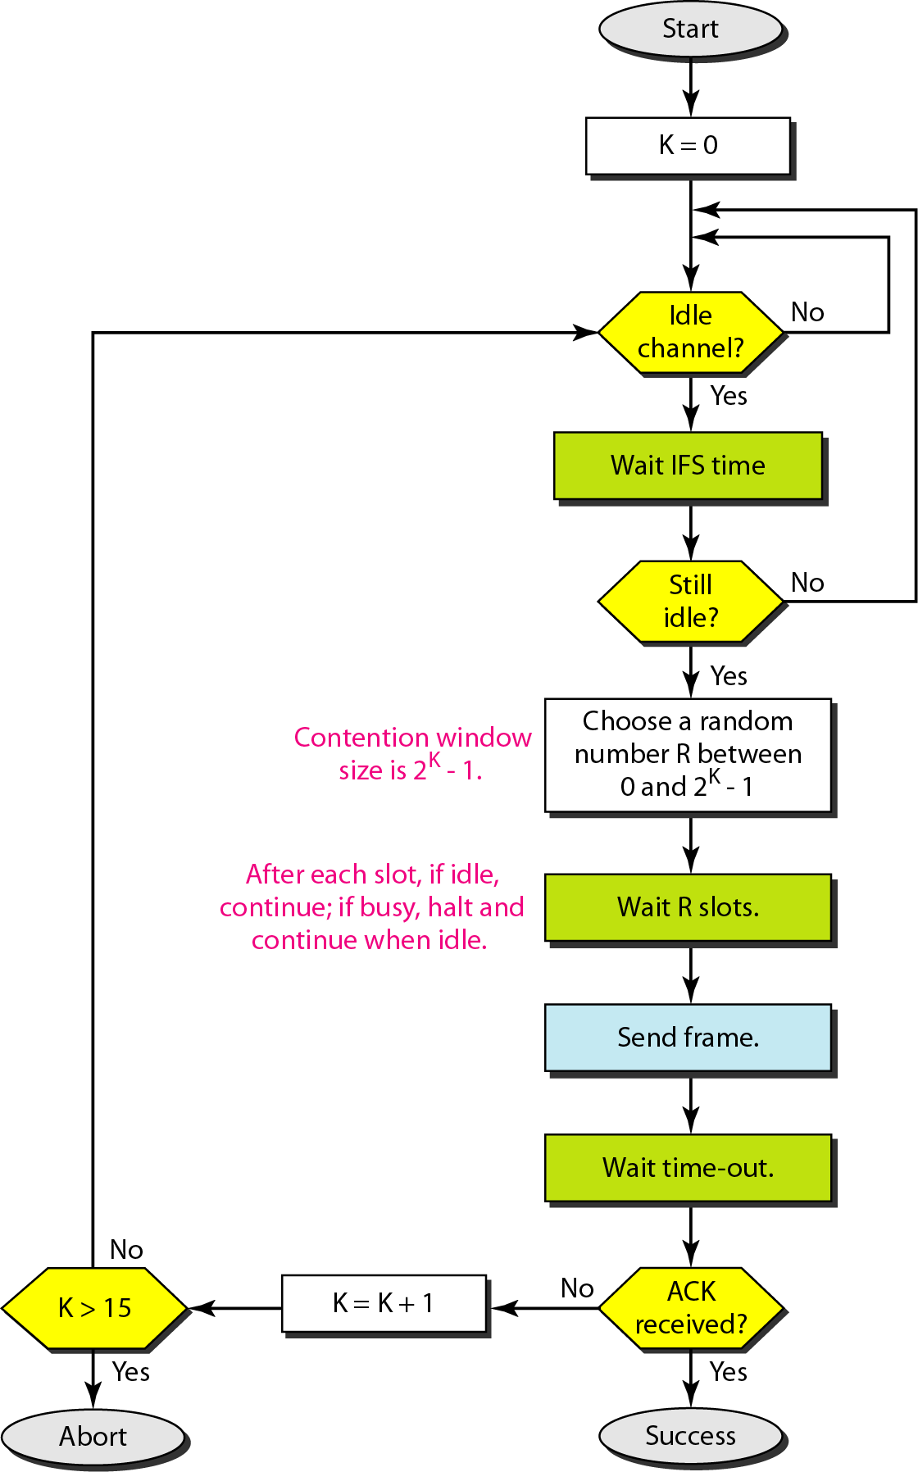
CSMA/CA: Flow Diagram

Slide 26
Contents
Data Link Layer Overview
Medium Access Control
Brief Introduction to Wireless Medium
Random Access
Controlled Access
Channelized Access

Slide 27
Medium Access Protocols

Slide 28
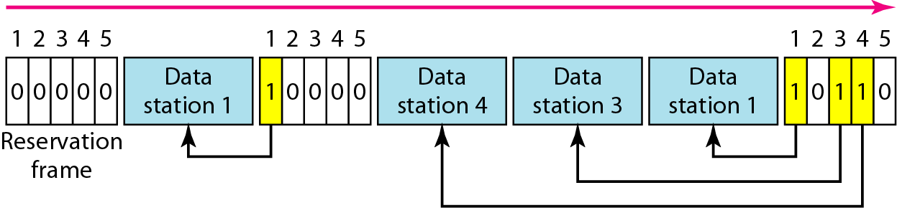
Controlled Access
The stations consult one another to find which station has the right to send
Reservation/Polling/ Token passing
Reservation access method:
Each station makes a reservation in its own mini-slot.
It needs a sophisticated synchronization: Less flexible.

Slide 29
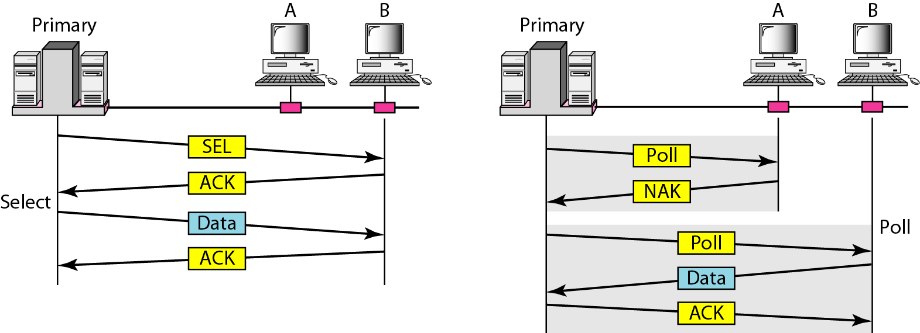
Polling: Select and Poll Functions
One primary and other secondary stations
How to exchanges data between A & B?
Through primary station
Can a secondary station ask for transmission without poll?
No

Slide 30
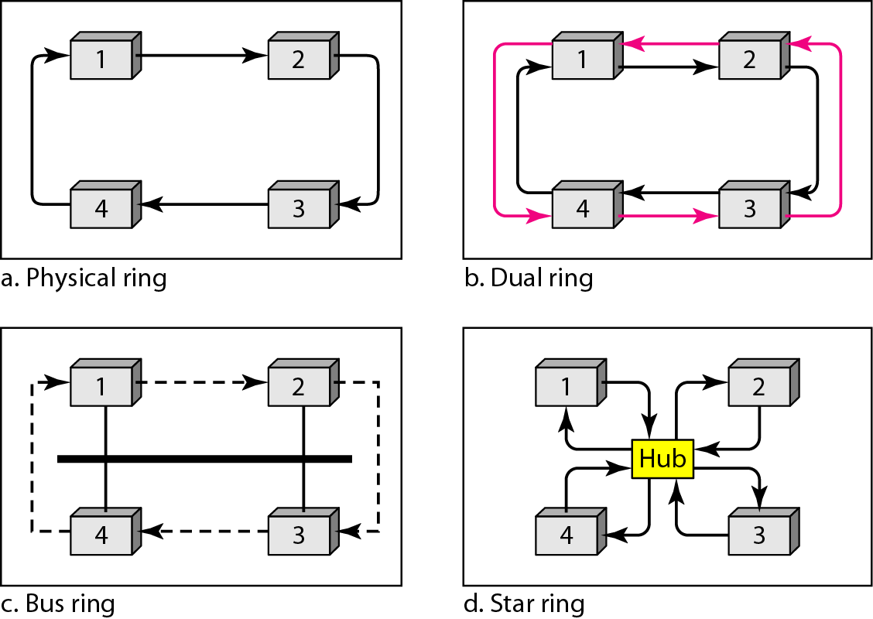
Token Passing
With token passing, network is organized in a Logical Ring.
Special packet called a token circulates through the ring.
Token is the right to access the network.
Token should be managed e.g. from loss.
Physical topologies:
Hub is a multiport repeater
(Layer 1 device).

Slide 31
Repeater & Hub
Repeater
Operates at the Physical layer of the OSI model
Has basic functions of
Receiving signal, cleaning up
Transmitting the signal on to the next link, bit by bit
Extends the network beyond the maximum length of a single segment
Connects segments of the same network (e.g. Ethernet), even if they use different media
Hub
Multi-port repeater
Bridge & Switch
Can perform basic CSMA/CD function of MAC layer
“Layer 2” device

Slide 32
Contents
Data Link Layer Overview
Medium Access Control
Brief Introduction to Wireless Medium
Random Access
Controlled Access
Channelized Access

Slide 33
Medium Access Protocols

Slide 34
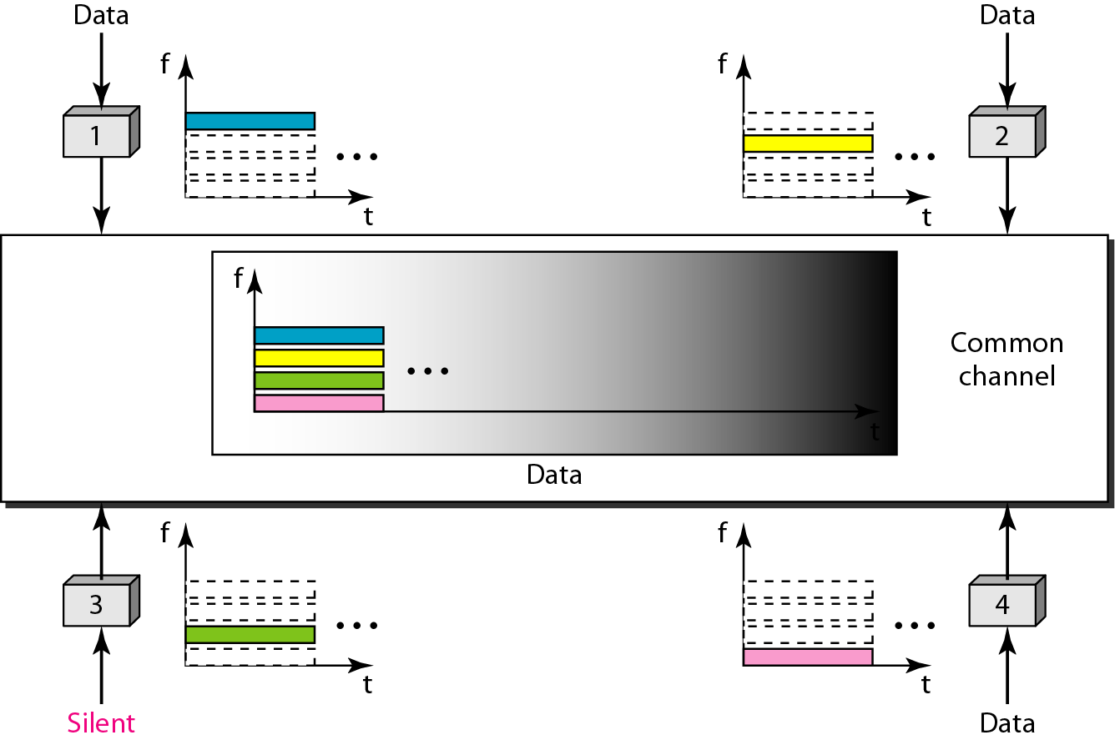
FDMA
Available bandwidth of the common channel is divided into bands that are separated by guard bands
FDMA is an access method in data link layer protocol.
FDM is a physical layer technique that combines lower bandwidth channels into a higher bandwidth channel

Slide 35
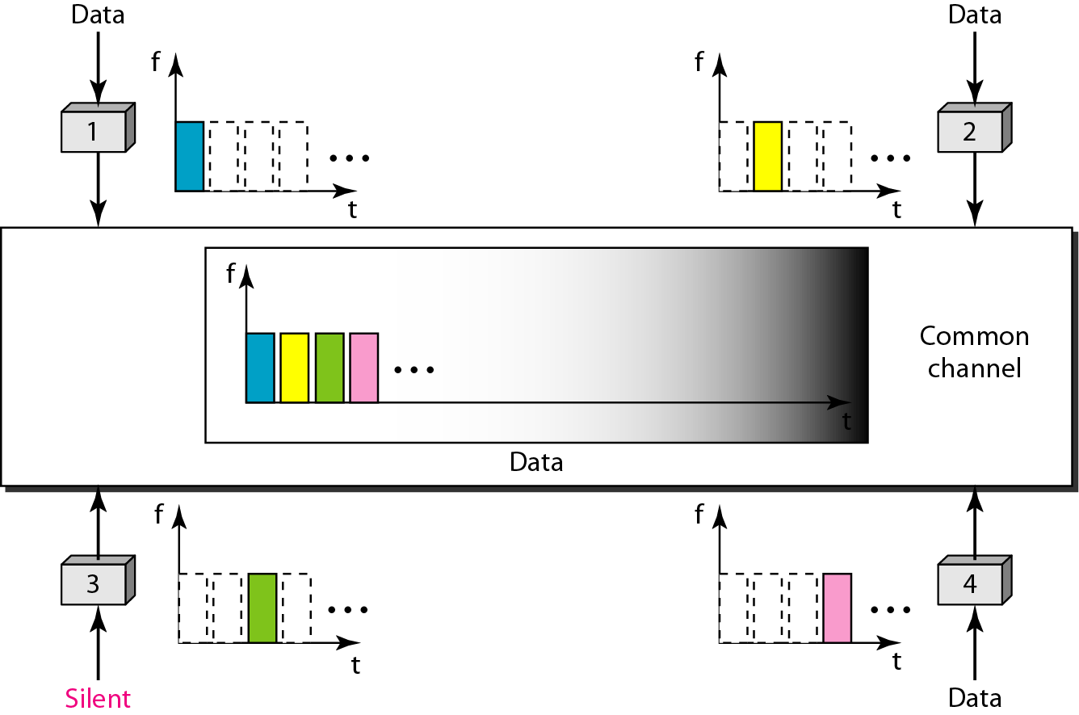
TDMA
The bandwidth is just one channel that is timeshared between different stations
Synch is needed, but maybe difficult because of propagation delay among stations.
This problem should be covered with guard time.
TDMA is an access method. TDM is a physical layer technique that combines slower input channels into faster output channels.

Slide 36
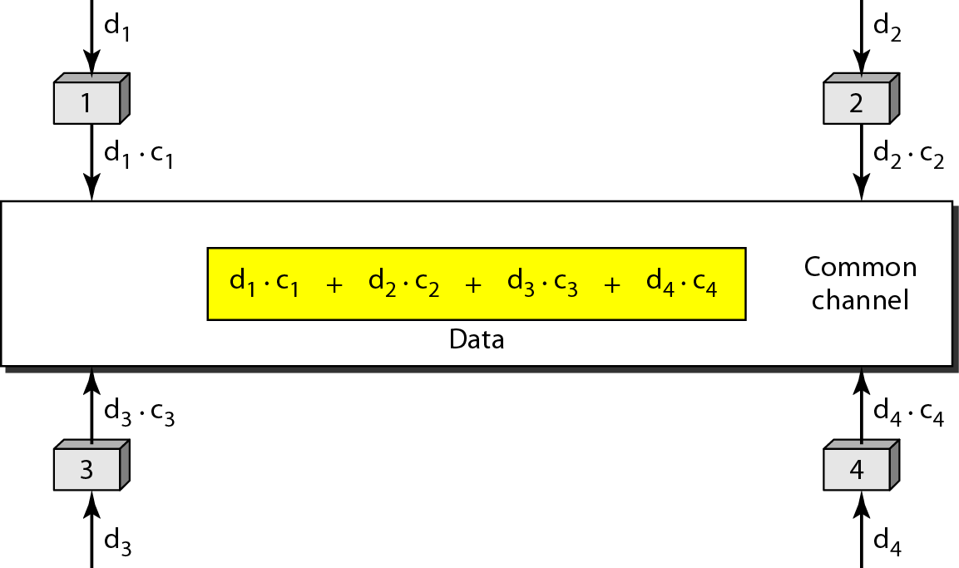
CDMA
One channel carries all transmissions simultaneously
Data from stations (d₁, d₂ , d₃ , d₄) are multiplied by codes (c₁, c₂, c₃, c₄) then sent.
Codes have two properties:
If we multiply each code by another, we get 0. (e.g. c2· c3 = 0)
If we multiply each code by itself, we get 4 (e.g. c2 · c2 = 4)
Data decoded by c₁ = (d₁.c₁ + d₂.c₂ + d₃.c₃ + d₄.c₄) .c₁
= d₁.c₁.c₁ + d₂.c₂.c₁ + d₃.c₃.c₁ + d₄.c₄.c₁ = 4.d₁

Slide 37
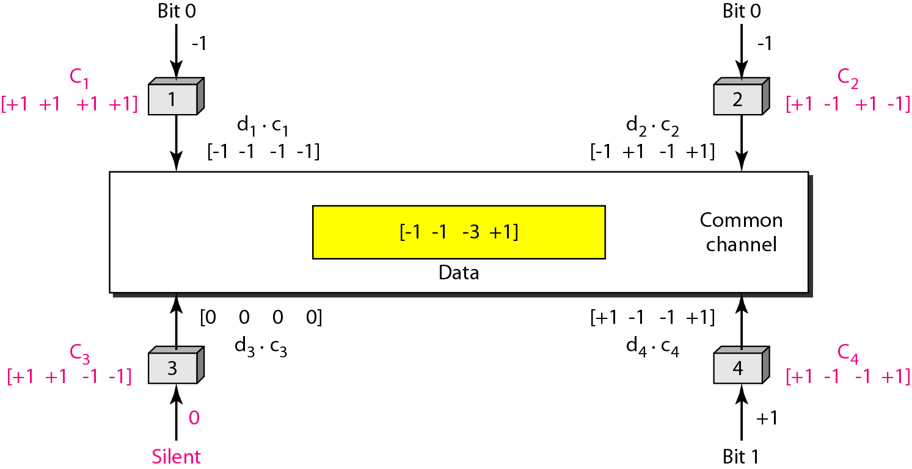
CDMA: Encoding and Decoding
How four stations share the link during a 1-bit interval

Slide 38
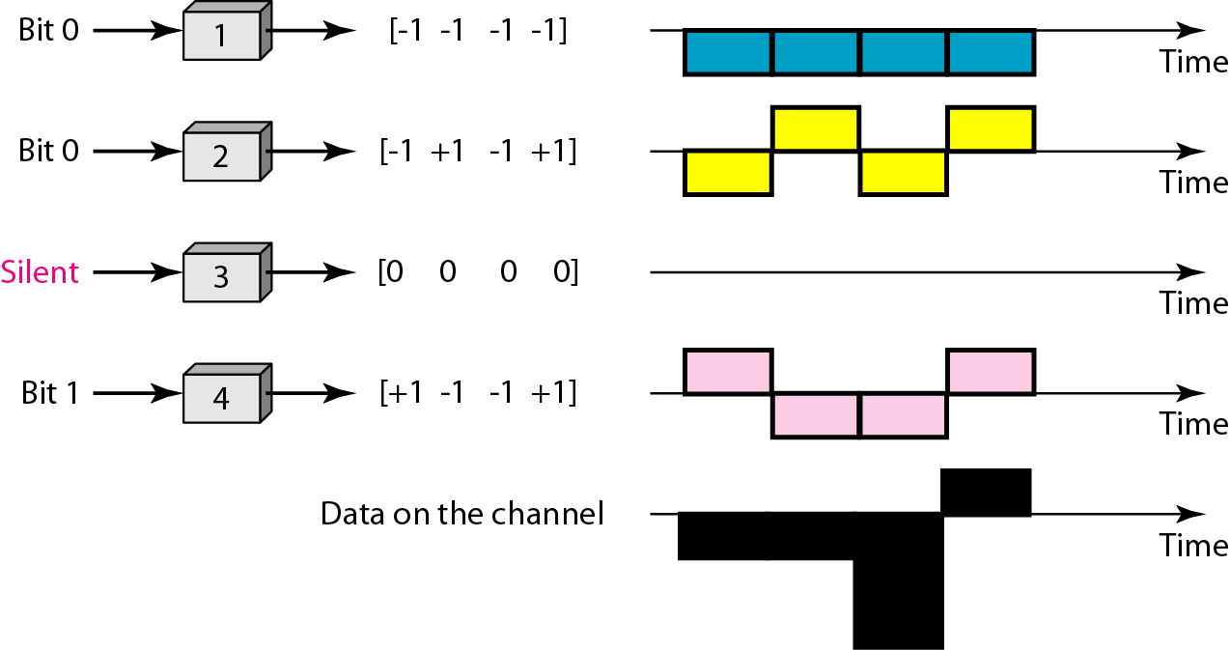
CDMA: Signal Level
Digital signal created by four stations in CDMA using NRZ-L for simplicity

Slide 39
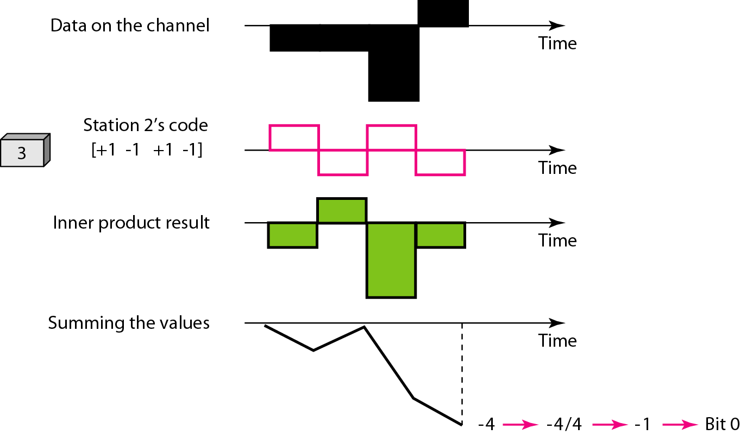
CDMA: Decoding
How station 3 can detect the data by station 2 by using the code for station 2
Decoding of the composite signal for one in CDMA

